Slide 1
Final Presentation on “IMAGE ENCRYPTION AND DECRYPTION USING AES & IWD”
PRESENTED BY: UNDER THE GUIDANCE OF:
Neelesh Singh(1309713058) Mr. RANJEET KUMAR
Digvijay Singh(1309713047)
Dinesh Kumar(1309713034)

Slide 2
CONTENTS
INTRODUCTION
PROBLEM FORMULATION
PROPOSED SOLUTION
Screenshots Of Running Program
RESULTS
CONCLUSION
FUTURE SCOPE
REFERENCES

Slide 3
Introduction
What Does Image Consist of…?
Image Encryption
Image Decryption

Slide 4

What is Cryptography?
Cryptography derived its name from a Greek word called “Kryptos” which means “Hidden Secrets”.
Cryptography is the practice and study of hiding information. It is the Art or Science of converting a plain intelligible data into an unintelligible data and again retransforming that message into its original form.
It provides Confidentiality, Integrity, Accuracy.

Slide 5
What is Encryption / Decryption
Encryption –
The process of converting plain text into an unintelligible format (cipher text) is called Encryption.
Decryption –
The process of converting cipher text into a plain text is called Decryption.

Slide 6
PROBLEM STATEMENT:
To Provide best Optimized Image after Decryption and to minimize the Performance Time.
Techniques used before
Blowfish
DES
Drawbacks of Previous Techniques
Less Secure
Less Optimized

Slide 7
PROPOSED SOLUTION
AES & IWD AES & IWD
INPUT IMAGE
ENCRYPTED IMAGE
DECRYPTED IMAGE

Slide 8
What is AES ..?
AES is an symmetric key encryption algorithm.
The input can be 128 bit or 192 bit or 256 bit, which will consist of the secret key .
In every round, there are four process which are subkey-generation, Bytesub, Shiftrow and add round key.

Slide 9
What is IWD ..?
IWD is a Swarm based nature inspired Algorithm
IWD can be used for Combinatorial Optimization Algorithm
This Algorithm Contains a few essential Elements of nature water drops and actions and reactions that occur between river’s Bed and water drops that flow within.

Slide 10
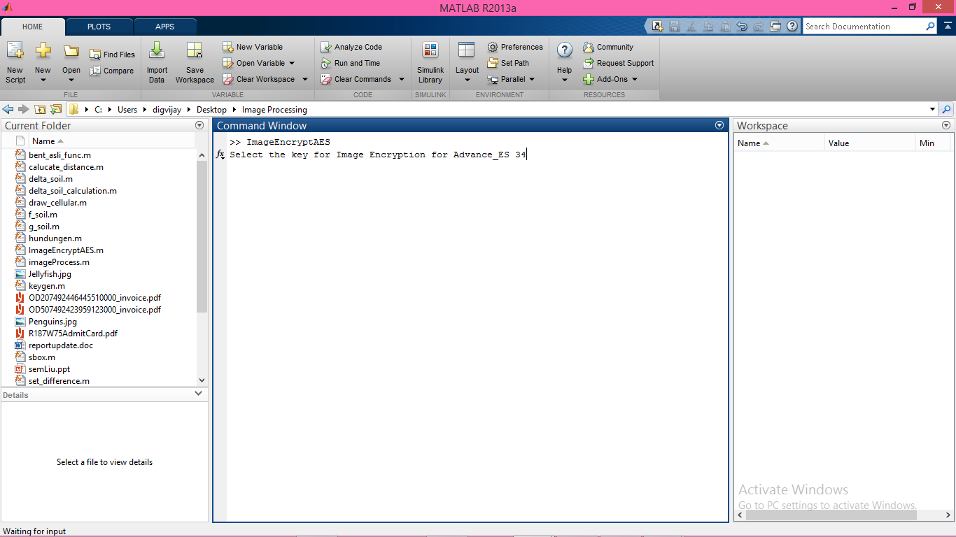

Slide 11
Screenshots Of Running Program

Slide 12
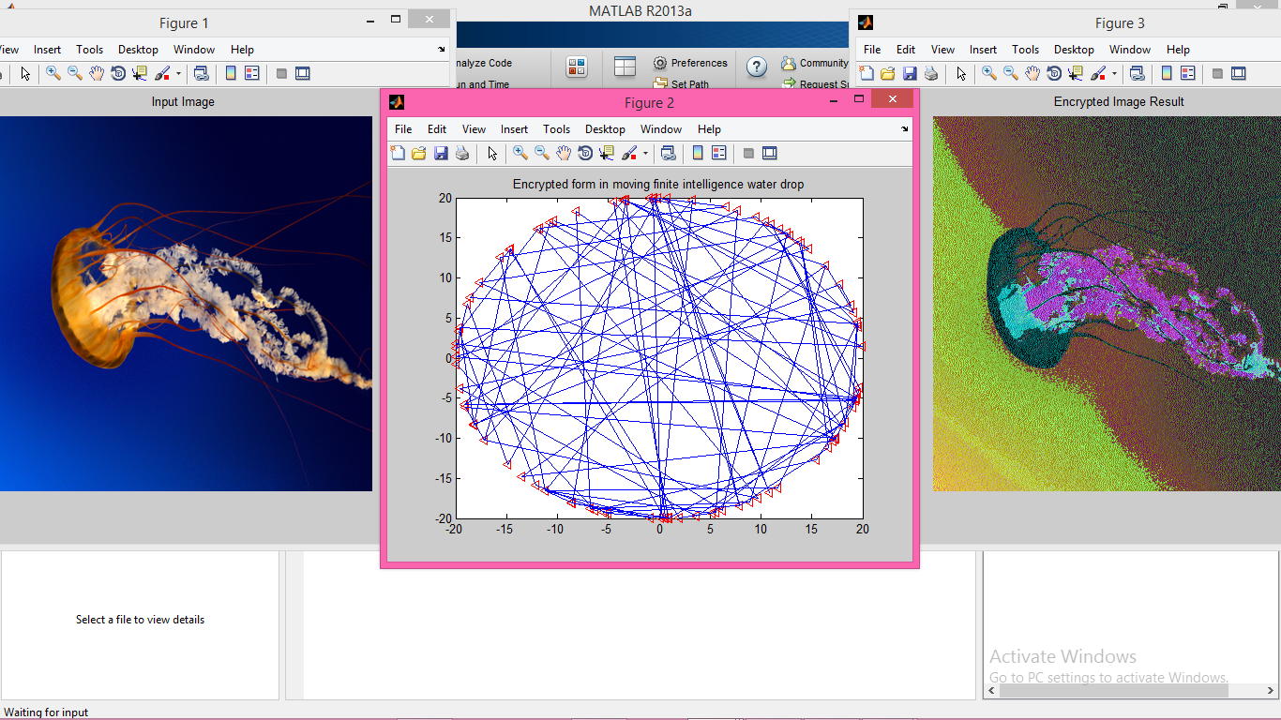

Slide 13
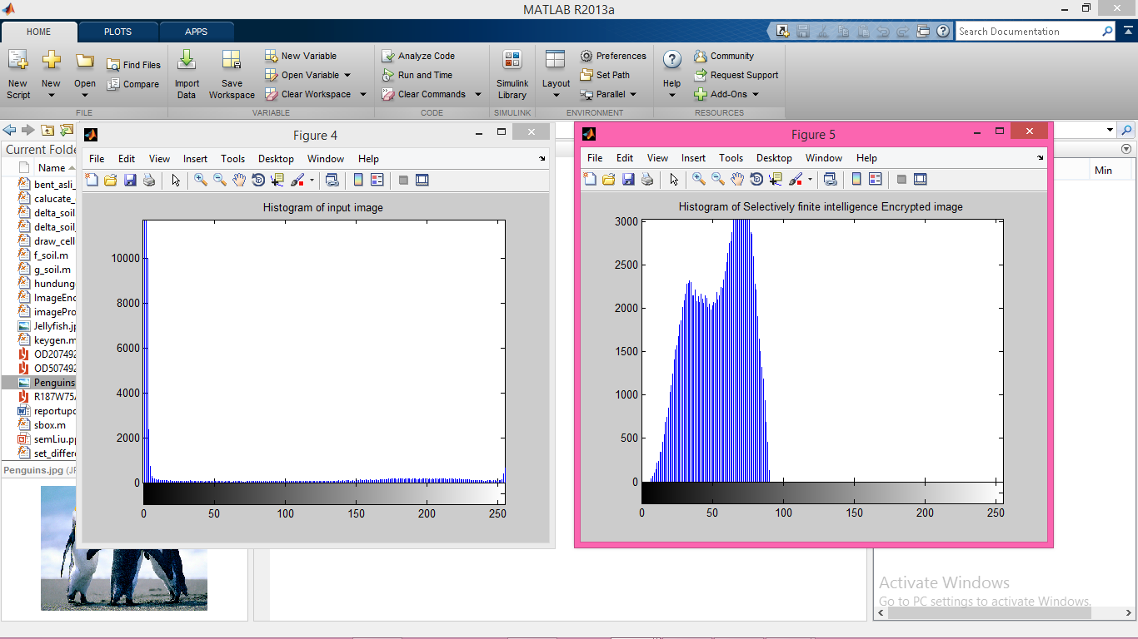

Slide 14
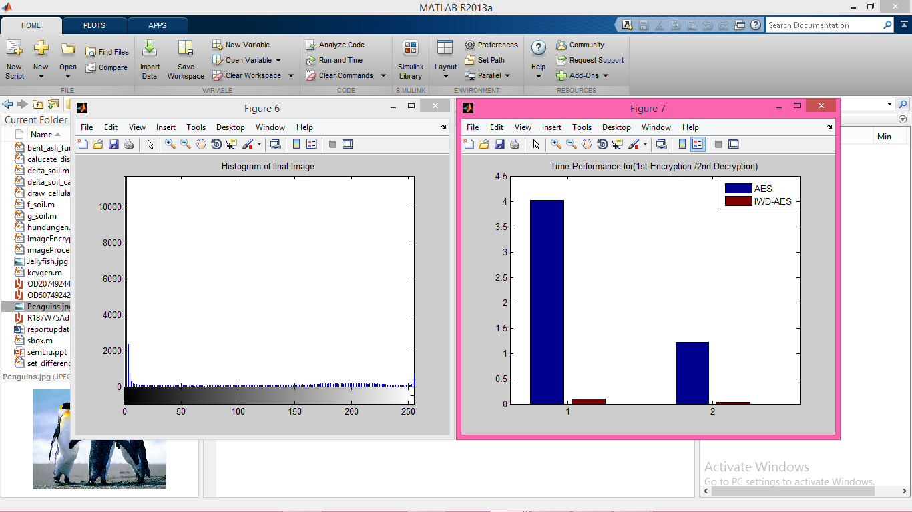

Slide 15
RESULTS
Image | Size of image(kb) | Encryption time using AES only(ms) | Encryption time using AES & IWD(ms)
jellyfish | 758 | 1.82 | .2
penguins | 760 | 1.83 | .14
Audi | 687 | 1.9 | .09

Slide 16
RESULTS Contd..
Image size (in pixels) | Image size (kb) | Decryption time using AES only(ms) | Decryption time using AES & IWD(ms)
jellyfish | 758 | 0.59 | 0.05
penguins | 760 | 0.6 | 0.04
audi | 687 | 0.56 | 0.05

Slide 17
CONCLUSION
→The aim of the cryptography is to prevent data from hackers.
→We also have shown the proposed algorithm gives better results from Advanced Encryption Standard and Modified Advanced Encryption Standard.
→In our proposal, we have presented the integrated approach of AES and IWD algorithm. From the present work, it has been observed that the results obtained using proposed concept are highly satisfactory and found an edge on AES & IWD algorithms.

Slide 18
FUTURE SCOPE
Image enhancing
Video Encryption
AES 192 or AES 256 may be used to further increase the key sensitivity and key space to the algorithm

Slide 19
REFERENCES
Hat Shah-Hosseini, H. Intelligent water drops algorithm: A new optimization method for solving the multiple knapsack problem. International Journal of Intelligent Computing and Cybernetics.
Simulation of Image Encryption using AES Algorithm by P.Karthigaikumar
J. Daemen, V. Rijmen: AES proposal: Rijndael. http://www.esat.kuleuven.ac. be/~rijmen/rijndael/rijndaeldocV2.zip
The Mathworks: Matlab , The Language of Technical Computing. http://www. mathworks.com/products/matlab,

Slide 20
THANK YOU

